Slide 1
Data Tribe: Disease Identification Problem we are addressing
Chronic diseases may represent a substantial health challenge for both patients and society, a thorough examination of the lumen is frequently necessary to diagnose and treat them.
However, the small bowel, due to its anatomical location, is less accessible for inspection by ﬂexible endoscopes commonly used for the upper GI tract and the large bowel. Since early 2000, video capsule endoscopy (VCE) has been used.
Sample video - https://www.youtube.com/watch?v=scHGobxmgWA
(Reference – “Capsovision” YT)

Slide 2
Team 225
Team Idea
Artificial intelligence (AI) is predicted to have profound effects on the future of video capsule endoscopy (VCE) technology. The potential lies in improving anomaly detection while reducing manual labour. However, medical data is often sparse and unavailable to the research community, and qualified medical personnel rarely have time for the tedious labelling work.
The goal is to build a deep learning model to classify images based on disease labels. The algorithms we are planning to use are deep neural networks, pretrained models to get better accuracy.

Slide 3
Who does it help?
The project is useful in health care field particularly to identify chronic and malignant diseases in children and adults.
Theme
The hackathon them it is connected to Artificial intelligence/ Machine learning. We leverage AI/ML algorithms to help support diagnostics.
Data
The data we are planning to use is Kvasir-capsule image data. It has nearly 70k images and their respective disease labels.

Slide 4
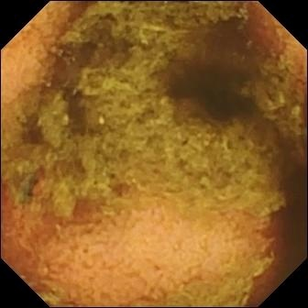
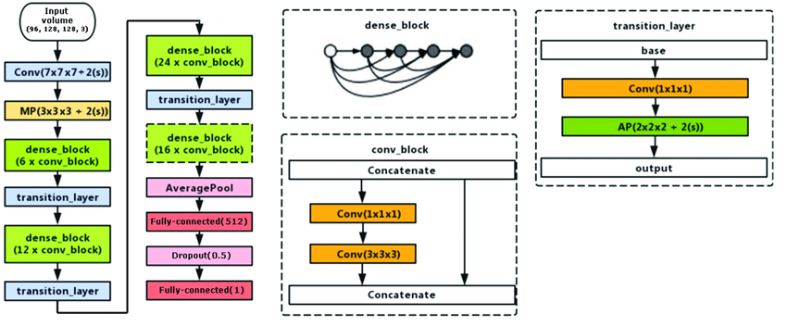
Team 225
Sample image and our model

Slide 5
Future Scope
This project has potential to go into the market given its best accuracy and reduction of manual labour. We will build a mobile application/website which takes input image and gives output results.
Currently, we are doing this for one disease but in future we can extend it to many diseases so it will be easy for doctors to identify diseases just using our website/application from images

